Slide 1

BITS PILANI · CSIW ZG628T DISSERTATION
CropAssist
An AI-Assisted Crop Recommendation and Farm Decision Support System Using Machine Learning
Student Project Training and Mentor Preparation
Python
FastAPI
React
PostgreSQL
scikit-learn
Academic Session 2026–2027
Proposal-stage training material · not an implemented or validated system
Notes:
TIME: 1 min (Section 1 · Motivation & problem — 10 min total)
PURPOSE: Welcome students and frame the session.
SAY: CropAssist combines an ordinary full-stack web application (React, FastAPI, PostgreSQL) with a deliberately lightweight machine-learning module. Today we will understand the problem, how the application is proposed to work, what evidence the AI model needs, and how to explain the project to a mentor.
KEY TERM — "decision support": the system helps a person decide; it does not decide for them.
ANALOGY: CropAssist is like a weather-forecast app — useful, data-based guidance, but the farmer still makes the final call.
ASK: "Has CropAssist already been built?"
SUGGESTED ANSWER: No. It is a proposed dissertation project. Everything in this session is a design, a plan or a labelled illustration.
LIMITATION: The artwork on this slide is an original illustration, not a photo of a real deployment.

Slide 2








What Will You Learn Today?
01 · MOTIVATION & PROBLEM
By the end of this session, students should be able to…
STAGE 1
STAGE 2
STAGE 3
STAGE 4
STAGE 5
STAGE 6
STAGE 7
Explain the agricultural problem
Describe the CropAssist solution
Identify the roles of React, FastAPI, PostgreSQL and Python ML
Explain how crop classifiers learn from data
Describe the complete user workflow
Identify evaluation and testing methods
Present the project confidently to a mentor
The goal today: clear conceptual understanding first — implementation skills follow through practical exercises.
Notes:
TIME: 1.5 min
CONCEPT: These seven learning outcomes are what students should be able to DO by the end, not just recognise.
SAY: The session is not meant to turn anyone into an agricultural specialist or an ML researcher today. First we build clear conceptual understanding; implementation skills come later through practical exercises.
ANALOGY: Like a first driving lesson — you learn what each control does before you drive on the highway.
ASK: "Which of these seven outcomes do you feel least confident about right now?"
SUGGESTED ANSWER: Most beginners pick stage 4 (how classifiers learn from data). Reassure them that Section 3 is devoted to it.
TIP: Return to this slide at the end as a self-check: students tick off each stage they can explain aloud.

Slide 3





What Is CropAssist?
01 · MOTIVATION & PROBLEM
A proposed web-based decision-support application — the project in 60 seconds
Soil & Environmental Data
ML Model
Crop Recommendation
Available measurements entered by the user
Python classifier trained on a labelled dataset
A model-based crop class, displayed and saved to history
1
A proposed web-based decision-support application
2
User enters available soil and environmental parameters
3
A Python machine-learning model processes them
4
The result is displayed and stored for future reference
A recommendation reflects patterns in a dataset — not a guarantee of field success.
Notes:
TIME: 1.5 min
CONCEPT: Input → model → output.
TERMS: A "feature" is one measured input (e.g. rainfall). A "class" or "label" is one of the crop categories the model can output.
SAY: In everyday language: a user types in soil and weather measurements; a Python model compares that pattern with what it learned from a historical labelled dataset; the app shows a crop class and saves it.
ANALOGY: Like a doctor comparing your test results with many past patient records — a well-informed suggestion, not a guarantee.
ASK: "Explain the project in one sentence."
SUGGESTED ANSWER: "CropAssist is a proposed web app where a user enters soil and environmental measurements and a trained ML model suggests a crop class, which is saved to the user's history."
LIMITATION: The recommendation shows which crop classes resemble conditions in the dataset. It does not confirm that a crop will succeed in a real field.

Slide 4
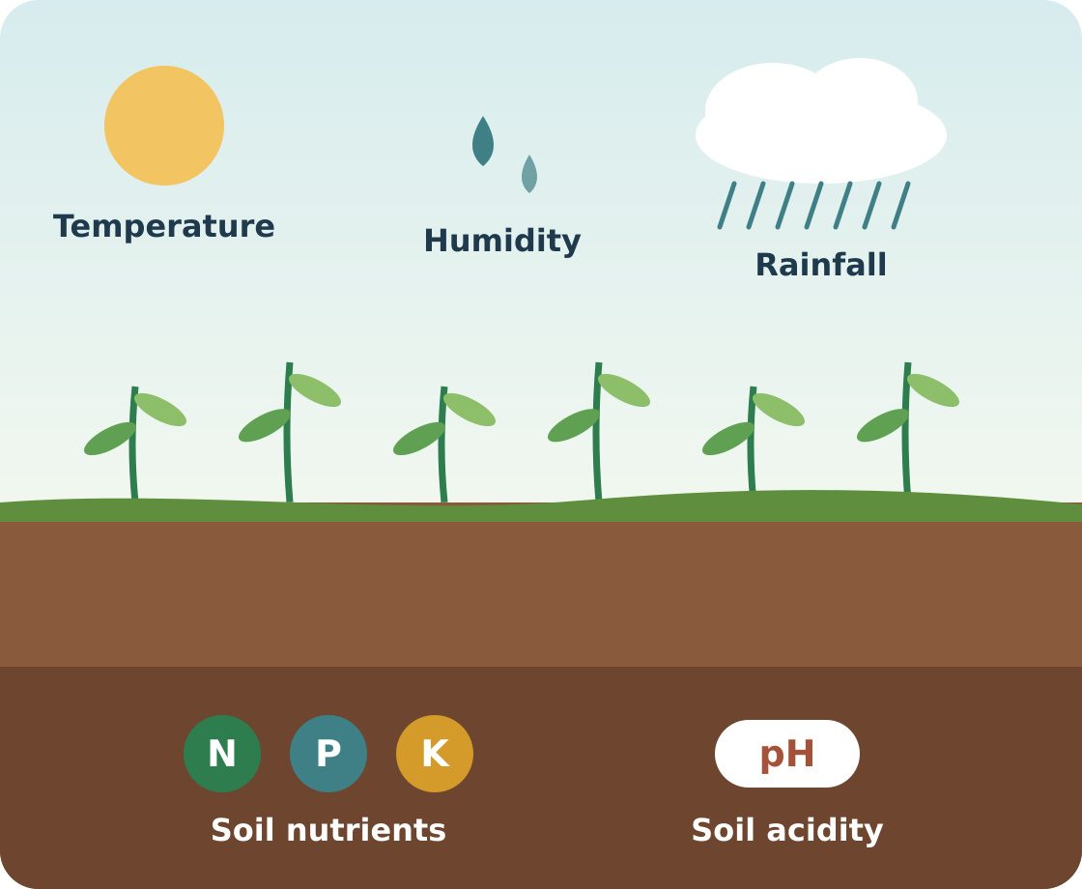




Why Is Crop Selection Challenging?
01 · MOTIVATION & PROBLEM
Crop suitability depends on many factors at the same time
Soil nutrient availability
Soil acidity or alkalinity (pH)
Temperature
Humidity
Rainfall
Local farming conditions
Season and crop-specific requirements
Weighing several parameters at once is difficult without suitable decision-support information.
Notes:
TIME: 1.5 min
CONCEPT: Crop selection is a multi-factor problem.
TERMS: N, P and K are nitrogen, phosphorus and potassium — major plant nutrients. pH measures how acidic (low) or alkaline (high) the soil is.
SAY: A farmer may know the temperature but not how a set of soil measurements relates to different crops. CropAssist proposes to model relationships that exist inside an available labelled dataset.
ANALOGY: Choosing a crop is like packing for a trip — you weigh temperature, rain and humidity together, not one at a time.
ASK: "Which important real-world factors might a typical student dataset NOT contain?"
SUGGESTED ANSWER: Market prices, irrigation availability, seed variety, pests and disease, soil texture, sowing date, and the farmer's own experience.
LIMITATION: The model can only learn from factors that are present in the dataset.

Slide 5




Intended Users and Their Needs
01 · MOTIVATION & PROBLEM
Three kinds of users — and a realistic scenario
Agricultural user / farmer
Administrator
Student / researcher
Enters environmental information, receives a recommendation and views previous results.
Maintains curated crop information and relevant application settings.
Studies how a supervised classifier can support agricultural decision-making.
ILLUSTRATIVE SCENARIO A user has soil-test information for a field and wants to explore model-supported crop options.
Notes:
TIME: 1.5 min
CONCEPT: Intended users versus the academic prototype.
SAY: In the real world the users would be farmers or agricultural advisers. In the dissertation demo we use fictional users and fields. The first version assumes users already have measurements from existing soil tests or observations — the app does not measure nutrients itself.
TERM — "persona": a short profile of a typical user, used to design screens around real needs.
ASK: "Where would a farmer get N, P and K values?"
SUGGESTED ANSWER: From a soil-testing laboratory report (for example a government soil-health card). CropAssist only accepts these values; it never measures them.
LIMITATION: Demo accounts and fields are fictional; no real farmer data should be used without consent.

Slide 6

Manual Interpretation vs. Data-Assisted Recommendation
01 · MOTIVATION & PROBLEM
Two parallel workflows for choosing a crop
Conventional process
Collect information
Consult resources or agricultural experts
Compare possible crops
Make a decision
Today
CropAssist proposal
Enter dataset-supported measurements
Validate inputs
Run the trained model
Display the predicted crop class
Review supporting information
Data-assisted
Key message: the application assists interpretation — it does not replace agricultural expertise.
Notes:
TIME: 1.5 min
CONCEPT: CropAssist adds a computational step; it does not replace expertise.
SAY: Be careful not to suggest that traditional agricultural knowledge is inferior. The proposal adds a consistent, data-based decision-support step. Its quality depends on training-data quality, feature relevance and generalisability.
TERM — "generalisability": how well a model works on data different from what it was trained on (another region or season, for example).
ANALOGY: A second opinion — useful alongside an expert, not instead of one.
ASK: "What does the proposed workflow add that the conventional one lacks?"
SUGGESTED ANSWER: Input validation, and a repeatable data-driven prediction that is recorded together with the model version, so every piece of advice can be traced later.
LIMITATION: If the dataset does not represent the user's region, the prediction may be misleading.

Slide 7


Academic Foundation of the Project
01 · MOTIVATION & PROBLEM
Problem → aim → research question
PROBLEM STATEMENT
How can a web application use available soil and environmental parameters to provide model-based crop-class recommendations?
AIM
Design, implement and evaluate a lightweight ML-powered agricultural decision-support application.
PRIMARY RESEARCH QUESTION
How effectively can selected supervised classifiers predict crop labels using the feature set supported by a chosen agricultural dataset?
Notes:
TIME: 1.5 min
CONCEPT: Problem, aim and research question are different things.
SAY: The problem says what needs support. The aim defines the system we intend to build. The research question states what we will investigate using evidence.
ANALOGY: Problem = "my bicycle keeps getting a flat tyre". Aim = "fit a puncture-resistant tyre". Research question = "how much does this tyre reduce punctures over 500 km?"
ASK: "Is 'build a crop recommendation app' a research question?"
SUGGESTED ANSWER: No — that is an aim. A research question must be answerable with evidence, e.g. how effectively selected supervised classifiers predict crop labels on the chosen dataset.
LIMITATION: "Effectively" must be defined by measurable metrics (for example macro-F1 on a held-out test set) that are chosen before running experiments.

Slide 8


What Are We Proposing to Build?
02 · OBJECTIVES, MODULES & ARCHITECTURE
Ten objectives in three groups — the ML model is one component of the whole
Application
AI / ML
Evaluation
User registration and login
Optional farm/field records
Input forms for supported measurements
React recommendation-results screen
Recommendation history in PostgreSQL
Dataset preparation and preprocessing
Comparison of lightweight ML classifiers
FastAPI prediction endpoint
Model-version tracking
Application (software) testing
ML model evaluation
Remember: building and validating the workflow, database and APIs matters as much as training the classifier.
Notes:
TIME: 2 min (Section 2 · Objectives, modules & architecture — 15 min total)
CONCEPT: The ML model is one component of a complete application.
SAY: Building and validating the user workflow, the database and the APIs matters just as much as training the classifier. Mentors will assess the whole system.
ANALOGY: The model is the engine; the application is the car. An engine on a workbench doesn't take anyone anywhere.
ASK: "Which objective are students most likely to underestimate?"
SUGGESTED ANSWER: Integration and traceability — reliably storing inputs, outputs and the model version — plus systematic testing. These take real time.
LIMITATION: Optional farm/field records may be simplified if time is short; document any such scope change.

Slide 9


What Is Included — and What Is Not?
02 · OBJECTIVES, MODULES & ARCHITECTURE
Firm boundaries keep a 16-week dissertation achievable
In scope
Out of scope (initial release)
Manual parameter entry
IoT and sensors
Selected supported crop classes
Satellite imagery
Lightweight supervised ML
Automated fertilizer prescriptions
Recommendation history
Image-based disease diagnosis
User and admin interfaces
Guaranteed yield prediction
Model traceability
Universal agricultural recommendations
Software testing and experimental evaluation
A smaller system with correctly tested features is academically stronger than an oversized, incomplete one.
Notes:
TIME: 2 min
CONCEPT: Scope control.
SAY: A 16-week dissertation needs firm boundaries. A smaller system with correctly tested features is academically stronger than an oversized project with incomplete modules.
TERM — "scope creep": features being added gradually until the project can no longer be finished well.
ASK: "A mentor suggests adding a live weather API. How do you respond?"
SUGGESTED ANSWER: Thank them, and record it as future work. It is outside the initial scope because it adds an external dependency, changes the input pipeline and complicates evaluation.
LIMITATION: "Selected supported crop classes" means the model can only recommend crops that appear as labels in the training data.

Slide 10






Main Functional Modules
02 · OBJECTIVES, MODULES & ARCHITECTURE
Seven modules coordinated by the FastAPI backend
1 Authentication
7 Administration
2 Farm / field management
FastAPI
backend
6 Recommendation history
3 Parameter input
5 Crop information
4 Crop classification (ML)
Notes:
TIME: 2.5 min
CONCEPT: Each module has one clear responsibility; FastAPI coordinates them.
SAY: Walk around the diagram. Point out that collecting inputs (parameter-input module) and running the model (classification module) are different tasks. Model-version traceability, the eighth proposed module, is delivered through the classification and history modules: every recommendation is linked to the model version that produced it.
KEY DISTINCTION: The database stores application records. The trained model file stores learned parameters.
ASK: "Are the model's learned parameters stored in PostgreSQL?"
SUGGESTED ANSWER: No. They live in the saved model file (e.g. created with joblib). PostgreSQL stores a reference to the model version that was used.
LIMITATION: Module boundaries are a design proposal and may be refined during implementation.

Slide 11




How the Technologies Work Together
02 · OBJECTIVES, MODULES & ARCHITECTURE
Layered architecture of the proposed system
React frontend
FastAPI backend
SQL via SQLAlchemy
PostgreSQL
Forms, results, history and dashboards
HTTP
JSON
REST APIs, validation, authentication and workflow coordination
Users, fields, recommendation inputs/outputs and model references
User
model loaded once (joblib); called in-process
Initial design choice
The trained model can be loaded directly inside the FastAPI application — no separate ML server is required for the first version.
Python ML inference
Analogy
React = the shop counter
FastAPI = the manager
PostgreSQL = the filing cabinet
Python ML = the specialist adviser
Preprocessing and prediction with the trained model
Notes:
TIME: 3 min
CONCEPT: How the four technologies cooperate.
SAY: Use the analogy on the slide. React is the counter the customer sees, FastAPI is the manager who checks and coordinates every request, PostgreSQL is the filing cabinet, and the Python ML component is the specialist adviser. In the first version the trained model is loaded directly inside the FastAPI application — no separate ML server is needed.
TERMS: REST API = a set of URLs the frontend calls over HTTP. JSON = the text format for the data exchanged.
ASK: "Why shouldn't the React frontend run the ML model itself?"
SUGGESTED ANSWER: The model is Python code on the server. The backend must authenticate the user, validate inputs and record history; running the model in the browser would bypass those controls.
LIMITATION: In-process loading suits a prototype. A high-traffic system might later need a separate model service.

Slide 12
From Input to Crop Recommendation
02 · OBJECTIVES, MODULES & ARCHITECTURE
The complete proposed user workflow, step by step
1
REACT
2
REACT
3
REACT
4
FASTAPI
5
ML MODEL
User logs in
Selects or creates a field record
Enters supported parameters
FastAPI validates the request
Trained model receives validated values
COLOUR KEY
9
REACT
8
REACT
7
POSTGRESQL
6
ML MODEL
REACT
FASTAPI
User inspects recommendation history
React displays the result
Backend stores input, output and model version
Model returns a crop-class prediction
ML MODEL
POSTGRESQL
Prediction ≠ saving. The result comes from the model; storing it is a separate backend step. Validation runs in the browser for usability and on the server for integrity.
Notes:
TIME: 3 min
CONCEPT: The end-to-end request path.
SAY: Walk through all nine steps using the colour key. Stress that the RESULT comes from the model, while SAVING it is a separate backend operation (step 7).
ASK: "Which component is responsible for validating data, and why must it also happen on the server?"
SUGGESTED ANSWER: FastAPI (using Pydantic models). Browser checks improve usability, but anyone can bypass them by calling the API directly — so the server must enforce validation before values reach the model.
ACTIVITY: Point to a random step and ask a student which technology handles it.
LIMITATION: The exact screens and steps may change during implementation; this is the proposed flow.

Slide 13

Technology Stack Explained
02 · OBJECTIVES, MODULES & ARCHITECTURE
Learn each tool by its role in the project
Technology | Layer | Purpose
React | Frontend | Dynamic browser interface
Python | Language | Data processing and ML
FastAPI | Backend | Backend services and REST APIs
PostgreSQL | Data | Relational data storage
scikit-learn | ML | Model training and inference
pandas | ML | Dataset loading and analysis
NumPy | ML | Numerical operations
SQLAlchemy | Backend | Database access from Python
Pydantic | Backend | Request data validation
Pytest | Testing | Automated backend testing
Foundations to revise first
Basic Python functions
JSON
HTTP requests (GET / POST)
React components and state
SQL basics (SELECT, JOIN)
Learn libraries by their role — not their internals.
Notes:
TIME: 2.5 min
CONCEPT: Know each technology by its role, not its internals.
TERMS: A library is reusable code you call (pandas). A framework calls your code in a defined structure (FastAPI). An ORM such as SQLAlchemy lets Python objects map to database tables. Pydantic checks that incoming data has the right types and fields.
ASK: "Pydantic and pandas both 'handle data'. How do their jobs differ?"
SUGGESTED ANSWER: Pydantic validates each incoming API request at run time. pandas is used offline to load, explore and clean the training dataset.
TIP: Students should record exact versions in requirements.txt and package.json so results are reproducible.
LIMITATION: Library choices may change slightly (for example a different test runner for React) — the roles stay the same.

Slide 14





What Information Does the ML Model Need?
03 · DATA & ML FUNDAMENTALS
Illustrative feature set — subject to the selected dataset
N
P
K
Nitrogen (N)
Phosphorus (P)
Potassium (K)
Temperature
Soil nitrogen measurement
Soil phosphorus measurement
Soil potassium measurement
Environmental temperature
Important
Actual input features, units and valid ranges must match the selected and verified dataset.
Humidity
pH
Rainfall
Relative humidity
Soil acidity / alkalinity
Rainfall measurement
Notes:
TIME: 6 min (Section 3 · Data & ML fundamentals — 20 min total)
CONCEPT: Features, units and valid ranges.
SAY: Do not teach any numbers as universal crop thresholds. NPK units differ across datasets. Temperature is usually in °C and humidity in %, but rainfall may be recorded per month, per season or per year in a dataset-specific unit. Every unit must be documented before the system is presented.
ANALOGY: A recipe written in grams fails if you measure in cups — the numbers look fine but mean something else.
ASK: "Why must the web form use exactly the same units as the training data?"
SUGGESTED ANSWER: The model only learned relationships in the dataset's units. Entering rainfall in cm instead of mm shifts the value tenfold and produces a meaningless prediction.
LIMITATION: This feature list is illustrative and depends on the dataset that is finally selected.

Slide 15



How Can a Computer Learn Crop Patterns?
03 · DATA & ML FUNDAMENTALS
Supervised learning: input features X → known crop label y
TRAINING · labelled examples
Example | Features X (7 measurements) | Label y
#1 | [ N, P, K, temp, humidity, pH, rainfall ] | Crop A
#2 | [ N, P, K, temp, humidity, pH, rainfall ] | Crop B
#3 | [ N, P, K, temp, humidity, pH, rainfall ] | Crop A
#4 | [ N, P, K, temp, humidity, pH, rainfall ] | Crop C
Learning algorithm
Trained model
Finds patterns that link X to y
Saved for reuse (e.g. with joblib)
INFERENCE · new, unlabelled input
New feature vector X
7 measurements · no crop label supplied
Trained model
Predicted label
The same saved model
e.g. 'Crop B' (hypothetical)
A prediction is not proof that the crop will succeed in a real field.
Notes:
TIME: 8 min
CONCEPT: Training versus inference.
TERMS: Feature vector X = the list of measurements for one example. Label y = the known crop recorded for that example. Training = the algorithm adjusts itself using many (X, y) pairs. Inference = the trained model receives only X and predicts y.
ANALOGY: Flashcards. While studying, you see the question and the answer (training). In the exam you see only the question and must produce the answer (inference).
ACTIVITY: Ask a student to point to the training half and the inference half of the slide.
ASK: "During inference, does the model see the crop label?"
SUGGESTED ANSWER: No. It receives only the features and predicts the label.
LIMITATION: The rows and "Crop B" output are hypothetical. A model can only output labels it saw during training, and a prediction is not proof that the crop is optimal in practice.

Slide 16




Why Data Quality Matters
03 · DATA & ML FUNDAMENTALS
From raw data to model-ready data
Raw dataset
Validation checks
Cleaned data
Model-ready data
BEFORE TRAINING — CHECKLIST
1
Verify the data source and permitted usage
5
Inspect class distribution
2
Understand feature definitions and units
6
Identify implausible values
3
Identify missing values
7
Define an appropriate data split
4
Inspect duplicate records
8
Keep preprocessing reproducible
Notes:
TIME: 6 min
CONCEPT: Data quality decides model quality.
TERMS: Provenance = where the data came from and whether we may use it. Class distribution = how many examples each crop has (imbalance means some have far fewer). Implausible value = e.g. negative rainfall or humidity above 100 %. Reproducible = someone else can rerun the steps and get the same data.
ANALOGY: A great recipe cannot rescue spoiled ingredients.
ASK: "Why are duplicate rows dangerous?"
SUGGESTED ANSWER: If the same (or nearly the same) row lands in both training and test sets, the model is tested on something it memorised, so accuracy is inflated — this is called leakage.
LIMITATION: Check the dataset licence permits academic use, and record every cleaning decision in the dissertation.

Slide 17


Proposed Model Training Process
04 · PIPELINE, ALGORITHMS & EVALUATION
Eight stages from labelled data to a deployed model
1 Labelled dataset
Train / validation / test split (illustrative proportions)
Training
Validation
Test
2 Data validation and cleaning
3 Exploratory data analysis
Model learns patterns from labelled examples
Compare models & tune settings
Final, untouched check — used once
4 Training / validation / test strategy
5 Comparable model training
Avoid leakage: fit preprocessing on training data only, and keep duplicates or near-duplicates out of the test set.
6 Performance evaluation
7 Selected model
Protocol pending: the exact strategy (e.g. stratified hold-out or cross-validation) is finalised after dataset selection.
8 FastAPI integration
Notes:
TIME: 4 min (Section 4 · Pipeline, algorithms & evaluation — 15 min total)
CONCEPT: Training, validation and test data have different jobs.
SAY: Training data teaches the model. Validation data (or cross-validation) helps compare models and tune settings. The held-out test set is used once at the end for an honest final estimate. The split proportions on the slide are illustrative only.
ASK: "Can we look at test results and then go back and change the model settings?"
SUGGESTED ANSWER: No. That turns the test set into validation data, so the final score becomes optimistic. Tune on validation data; use the test set once.
TERM — "stratified split": keeps each crop's proportion similar in every split.
LIMITATION: The exact evaluation protocol is finalised only after the dataset is chosen.

Slide 18
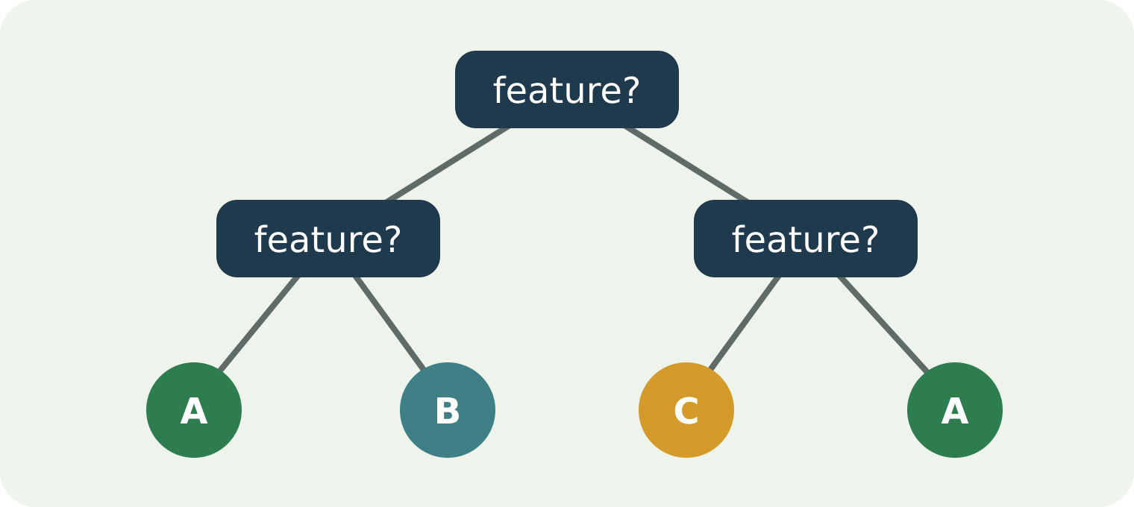
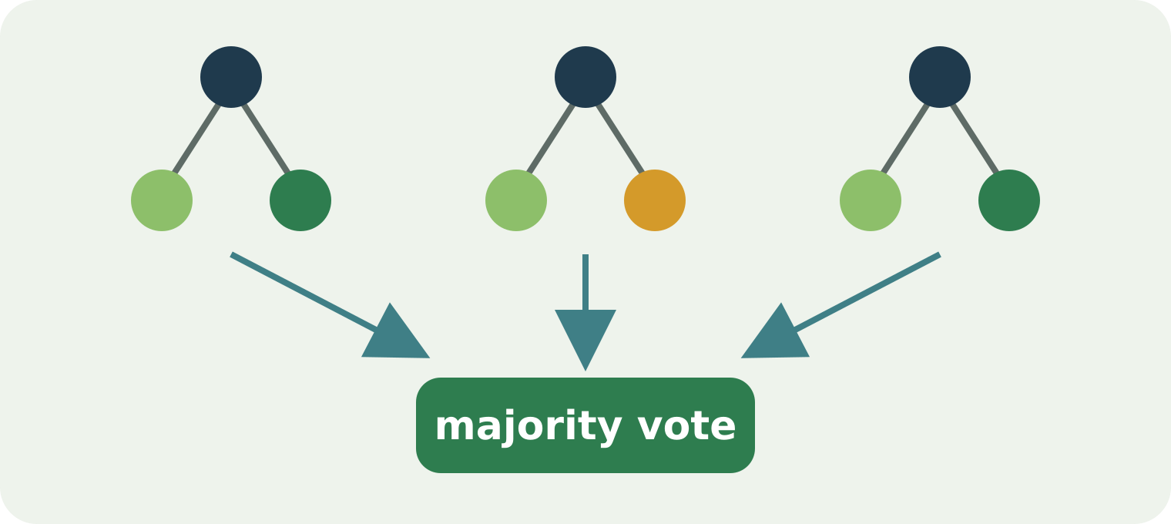
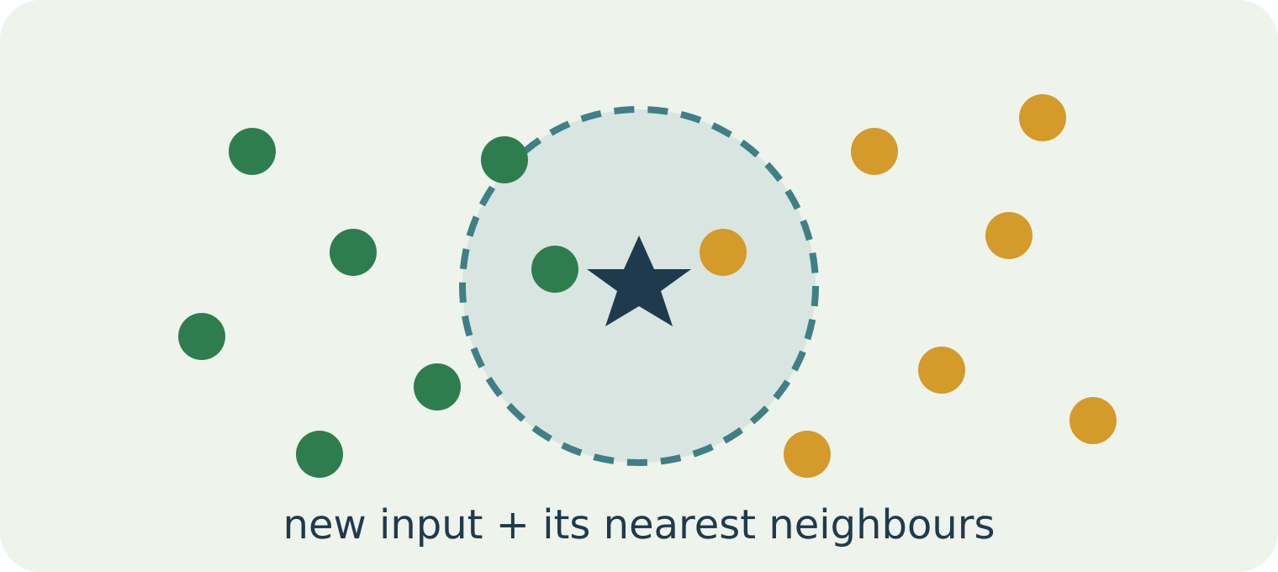
Which Algorithms Will We Compare?
04 · PIPELINE, ALGORITHMS & EVALUATION
Three lightweight, explainable candidate classifiers
Decision Tree
Random Forest
K-Nearest Neighbors
Learns a hierarchy of feature-based decision rules.
Combines predictions from many decision trees.
KNN uses nearby labelled examples in a chosen feature space to predict the class.
Compare on:
Predictive performance
Model complexity
Preprocessing needs
Inference behaviour
Notes:
TIME: 4 min
CONCEPT: Three lightweight, explainable classifiers to compare.
ANALOGIES: Decision Tree = a flowchart of yes/no questions about the features. Random Forest = asking many slightly different flowcharts and taking a majority vote. KNN = "tell me what your nearest neighbours grow".
SAY: Trees and forests handle non-linear interactions by splitting on feature thresholds. KNN relies on distances, so it usually needs feature scaling. Do not declare a "best" algorithm before running the experiments.
ASK: "Why might KNN need feature scaling?"
SUGGESTED ANSWER: Distances are dominated by features with large numbers (rainfall in the hundreds) over small ones (pH around 5–8). Scaling puts features on comparable ranges so each one contributes fairly.
LIMITATION: The diagrams are conceptual illustrations, not outputs of trained models.

Slide 19
How Will We Know Whether the AI Works?
04 · PIPELINE, ALGORITHMS & EVALUATION
Candidate metrics, an honest results template, and the confusion matrix
Candidate metrics
Results template
NO EXPERIMENTS RUN YET
Confusion matrix (concept)
Accuracy
Model | Accuracy | Macro-F1
Decision Tree | TBD | TBD
Random Forest | TBD | TBD
KNN | TBD | TBD
Predicted class →
Crop A
Crop B
Crop C
Precision
Crop A
correct
error
error
Recall
Crop B
error
correct
error
F1-score
Why macro-F1?
It averages F1 across crop classes with equal weight, so rare crops count as much as common ones.
Crop C
error
error
correct
Macro-F1
Confusion matrix
Actual class ↓ (rows)
Diagonal = correct predictions; off-diagonal cells show which crops are confused.
Per-crop performance
Notes:
TIME: 4 min
CONCEPT: Choosing honest metrics.
TERMS: Accuracy = fraction of evaluated examples classified correctly. Precision (for a crop) = of everything predicted as that crop, how much was right. Recall = of all true examples of that crop, how many were found. F1 = balance of precision and recall. Macro-F1 = average F1 across crops with equal weight. Confusion matrix = table of actual versus predicted classes.
ASK: "Why can accuracy alone be misleading?"
SUGGESTED ANSWER: If one crop dominates the dataset, a model can score high accuracy by mostly predicting that crop while failing the rare ones. Per-class metrics and macro-F1 expose this.
RULE: The table shows TBD on purpose. Never display invented results; every final number must come from actual evaluation code.

Slide 20



Can the Model Be Trusted Everywhere?
04 · PIPELINE, ALGORITHMS & EVALUATION
Research limitations and responsible AI
The dataset may represent only selected crops
Geographic conditions may differ
Soil measurements may be unavailable or inconsistent
Seasons and farming practices may be missing
Predictions can be incorrect
Unseen conditions may differ from training data
REQUIRED USER-FACING MESSAGE
“Model-based crop recommendation for informational decision support; consult qualified agricultural guidance before making cultivation decisions.”
Notes:
TIME: 3 min
CONCEPT: Statistical prediction is not agronomic validation.
SAY: A high score on one dataset does not prove the model suits every region, season or farming practice. Inputs that differ from the training data are called out-of-distribution, and predictions on them are less reliable. The application must show the advisory message on every result.
ANALOGY: A student who aces one textbook's exercises may struggle with a different syllabus.
ASK: "Our model scored highly on its test set. Can we tell farmers anywhere to trust it?"
SUGGESTED ANSWER: No. The score only describes performance on data similar to the dataset. Other regions, soils, seasons and practices may differ, so results must be treated as informational and checked with qualified agricultural guidance.
LIMITATION: The project does not include field trials, so real-world effectiveness is not measured.

Slide 21
What Will PostgreSQL Store?
05 · BACKEND, UI, SECURITY & TESTING
Conceptual entity-relationship design — illustrative attribute names
USER
FIELD
RECOMMENDATION
MODEL_VERSION
1
N
1
N
N
1
PK user_id
email · password_hash
PK field_id · FK user_id
name · location
PK rec_id · FK field_id
FK crop_id · FK model_version_id
created_at
PK model_version_id
algorithm · version · trained_at
1
N
N
Key relationships
One user may manage multiple fields
One field may have multiple recommendations
Each recommendation records the model version used
A recommendation stores its input values and resulting crop class
RECOMMENDATION_INPUT
CROP
1
PK input_id · FK rec_id
feature_name · value · unit
PK crop_id
name
1
N
CROP_INFORMATION
PK info_id · FK crop_id
description · source
Application records are not the ML training dataset.
Notes:
TIME: 3 min (Section 5 · Backend, UI, security & testing — 15 min total)
CONCEPT: Relational design and traceability.
TERMS: Primary key (PK) = unique ID of a row. Foreign key (FK) = a column pointing to a row in another table. "1 – N" = one row on the left relates to many on the right.
SAY: Recommendation history must preserve the original inputs and the model version. The database stores application evidence; it is NOT the training dataset.
ASK: "Why store the inputs if we already store the predicted crop?"
SUGGESTED ANSWER: To explain, audit or reproduce a past recommendation you need the exact inputs and the model version that produced it.
LIMITATION: This is a conceptual schema with illustrative attribute names. Final tables are designed during implementation.

Slide 22
How Will React Communicate With Python?
05 · BACKEND, UI, SECURITY & TESTING
Proposed FastAPI REST endpoints — a design, not running code
GET
/api/v1/crops
POST /api/v1/recommendations · illustrative request body
List supported crops
{
"field_id": 5,
"nitrogen": 70,
"phosphorus": 40,
"potassium": 50,
"temperature": 27,
"humidity": 75,
"ph": 6.5,
"rainfall": 180
}
POST
/api/v1/recommendations
Submit inputs → model recommendation
GET
/api/v1/recommendations
List my recommendation history
GET
/api/v1/recommendations/{id}
View one recommendation
POST
/api/v1/fields
Create a field record
GET
/api/v1/fields
List my fields
Example values are illustrative, not validated measurements; units and bounds come from the dataset. User identity comes from authentication — never a client-supplied ID.
Auth → Validate → Predict → Store → Respond
Notes:
TIME: 3.5 min
CONCEPT: How React talks to Python.
TERMS: GET reads data; POST creates something. An endpoint is a URL path plus a method. JSON is the text format of the request and response. A status code (200, 400, 401, 404) tells the client what happened.
SAY: The backend validates the request body with Pydantic before calling the model, then stores the recommendation and returns JSON.
ASK: "Should the request body include a user_id?"
SUGGESTED ANSWER: No. The backend gets the user from the verified authentication token or session. Trusting a client-supplied ID would let anyone act as another user. The backend must also check that field_id belongs to that user.
LIMITATION: The example values are illustrative and not validated agricultural measurements. Units and bounds come from the dataset.

Slide 23
What Will the User See?
05 · BACKEND, UI, SECURITY & TESTING
Proposed React pages and an illustrative result screen
Proposed pages
cropassist.local/recommendations/result
MOCKUP — not a screenshot of working software
1
Login / Register
Crop Recommendation Result
Dashboard
2
Dashboard
Fields
MODEL RECOMMENDATION
3
Farm / field records
New input
Rice
4
Enter soil & environmental parameters
Result
Model version: v1 (example)
History
Input record: Saved
5
Crop recommendation result
Admin
Status: Model-based recommendation
6
Recommendation history
Informational decision support — consult qualified agricultural guidance before making cultivation decisions.
7
Basic admin page
Notes:
TIME: 2.5 min
CONCEPT: Proposed user interface.
SAY: This is a mockup drawn for training, not a screenshot of working software. "Rice" and "v1" are hypothetical examples.
REACT CONCEPTS TO KNOW: components (reusable UI pieces), controlled inputs (form fields whose value lives in state), state (data that changes the screen), API calls (fetch/axios to FastAPI), and clear error messages.
ASK: "Besides the crop name, what should the result screen show?"
SUGGESTED ANSWER: The model version, confirmation that the input record was saved, a clear "model-based recommendation" status, and the advisory disclaimer.
LIMITATION: The final layout will follow usability feedback and time available.

Slide 24










What Can Go Wrong?
05 · BACKEND, UI, SECURITY & TESTING
Input validation and application security safeguards
INPUT
INPUT
INPUT
ILLUSTRATIVE ERROR
Rainfall
Required-field validation
Numeric type checking
Documented feature ranges and units
abc
Rainfall must be a numeric value in the supported measurement unit.
SECURITY
SECURITY
SECURITY
Authentication
Record-ownership checks
Secure password handling
Frontend validation
Usability — fast feedback
RELIABILITY
RELIABILITY
SECURITY
Backend validation
Integrity — cannot be bypassed
Controlled error responses
Logging and model-load failure handling
Protection of user history
Notes:
TIME: 3 min
CONCEPT: Frontend validation is for usability; backend validation is for integrity.
SAY: Invalid or arbitrary values must never reach the model unchecked. A user must never see another person's private field records. Passwords are stored as salted hashes (e.g. bcrypt or argon2), never as plain text.
ANALOGY: The front desk checks your form is filled in (frontend); the vault door checks your identity no matter what (backend).
ASK: "A user changes field_id in the request to someone else's field. What should happen?"
SUGGESTED ANSWER: The backend checks record ownership and rejects the request (for example 403 or 404) without revealing anything about the other record.
LIMITATION: This is prototype-level security, not a full production security audit.

Slide 25


Two Different Types of Verification
05 · BACKEND, UI, SECURITY & TESTING
ML evaluation and software testing answer different questions
ML EVALUATION ASKS…
SOFTWARE TESTING ASKS…
Does the application behave correctly?
Does the trained classifier predict crop labels correctly on the chosen held-out dataset?
PLANNED TEST SCENARIOS
Valid login
Invalid login
Missing input
Non-numeric input
Valid prediction request
History storage
Evidence: accuracy, macro-F1 and a confusion matrix on held-out data.
Incorrect record ownership
Unavailable model file
API error handling
Report them separately — high accuracy cannot fix broken authentication, and a working UI does not prove model quality.
Notes:
TIME: 3 min
CONCEPT: Two independent kinds of verification.
SAY: ML evaluation measures prediction quality on held-out data. Software testing checks that the application behaves correctly. High classifier accuracy cannot compensate for broken authentication or wrong database storage, and a working React screen does not prove model quality. Report them separately.
TERMS: Unit test = checks one function. Integration test = checks parts working together (e.g. FastAPI TestClient calling an endpoint that writes to a test database).
ASK: "What should happen in the 'unavailable model file' test?"
SUGGESTED ANSWER: The API should return a controlled error (e.g. 503 with a clear message), log the failure, and never crash or return a fake prediction.
LIMITATION: No tests have been run yet; these are planned scenarios.

Slide 26
What Will We Demonstrate to the Mentor?
06 · DEMO, PLAN & VIVA
Planned demonstration sequence and a classroom exercise
Proposed demonstration sequence
CLASSROOM EXERCISE
1
Open CropAssist
6
Display the returned model prediction
Draw the request path
Sketch how one request travels from the React form to FastAPI, the trained model and PostgreSQL — and back.
2
Sign in with a demonstration account
7
Show the saved recommendation history
3
Select a fictional field
8
Explain which model version produced the result
React form
FastAPI
4
Enter a valid example input
9
Demonstrate one validation error
Trained model
PostgreSQL
5
Submit a recommendation request
Planned demonstration — until a prototype exists, use clearly labelled mockups.
Notes:
TIME: 6 min including a 4-minute exercise (Section 6 · Demo, plan & viva — 15 min total)
CONCEPT: A planned, honest demonstration.
SAY: This is the intended demo once a prototype exists. Until then, use conceptual screens clearly labelled as mockups — never present them as running software.
EXERCISE: Each student draws the request path. Expected answer: React form → POST /api/v1/recommendations (JSON) → FastAPI authenticates and validates → model predicts → backend stores inputs, result and model version in PostgreSQL → JSON response → React shows the result.
ASK: "Why deliberately demonstrate a validation error?"
SUGGESTED ANSWER: It shows the system handles bad input safely. Mentors value evidence of robustness, not just the happy path.
LIMITATION: Use fictional fields and documented example inputs only.

Slide 27

From Dissertation Proposal to Working Application
06 · DEMO, PLAN & VIVA
Proposed 16-week work plan and college submission milestones
1
2
3
4
5
6
7
8
9
10
11
12
13
14
15
16
Problem, literature & dataset search
W1–2
Data review, requirements & design
W3–4
Preprocessing & baseline models
W5–7
FastAPI, PostgreSQL, auth & inference API
W8–10
History, React frontend & admin
W11–13
Integration tests & final ML experiments
W14–15
Dissertation & demo preparation
W16
22 Oct 2026 · Abstract soft copy
Passed — confirm submission status
2 Dec 2026 · Mid-sem report soft copy
Describe the prototype actually completed
20 Jan 2027 · Final report soft copy
Measured results + demonstration
Notes:
TIME: 3 min
CONCEPT: Planning and evidence of progress.
SAY: The dates are college submission milestones, not proof of completed work. Because this training is delivered after 22 October 2026, the abstract deadline has already passed — confirm whether it was submitted. The bars show the proposed 16-week plan and should be adjusted once the dataset is chosen.
ASK: "What should go into a weekly progress log?"
SUGGESTED ANSWER: Completed code (commit links), tests run and their results, screenshots of real working features, decisions taken, obstacles, and next week's plan.
ANALOGY: A lab notebook — if it isn't written down, the examiner can't credit it.
LIMITATION: Model development is scheduled before the full UI; real progress may require re-planning.

Slide 28
Are You Ready to Explain CropAssist?
06 · DEMO, PLAN & VIVA
Mentor presentation, mock viva and recap
90-SECOND PROJECT EXPLANATION
MENTOR QUESTIONS
“Our proposed project, CropAssist, is an AI-assisted agricultural decision-support web application. It addresses the challenge of interpreting several soil and environmental parameters when exploring crop suitability. Users will enter supported measurements through a React interface. FastAPI will validate requests and invoke a Python ML model trained on a labelled agricultural dataset. PostgreSQL will store user, field and recommendation history. We plan to compare lightweight classifiers — Decision Tree, Random Forest and KNN — and evaluate the selected model with classification metrics. The expected outcome is a working crop-recommendation prototype with clearly communicated limitations.”
Why did you select this project?
Why is AI required?
What is supervised learning?
Where will the dataset come from?
Why did you select these algorithms?
What is the difference between training and prediction?
How will React connect to FastAPI?
What will PostgreSQL store?
How will model accuracy be verified?
What are the major limitations?
Understand the problem
Explain the architecture
Defend the ML approach
Demonstrate the evidence
Notes:
TIME: 6 min
CONCEPT: Communicating the project confidently and honestly.
HOW TO RUN: Pair students. One delivers the 90-second explanation without reading the slide; the partner asks three random mentor questions. Swap. Finish by asking each student to describe the complete workflow in under two minutes.
MODEL ANSWERS FOR KEY QUESTIONS:
Q2 Why is AI required? — Relationships among several soil and weather parameters are hard to hand-code as rules; a classifier can learn them from labelled data, while remaining decision support.
Q6 Training vs prediction? — Training learns from labelled examples offline; prediction applies the saved model to new, unlabelled inputs.
Q9 How will accuracy be verified? — Metrics such as accuracy, macro-F1 and a confusion matrix on a held-out test set, with values produced only by real evaluation code.
CHALLENGE: Whenever a student says "the system does…", ask "is that proposed or completed?"
CLOSING: Understand the problem. Explain the architecture. Defend the ML approach. Demonstrate the evidence.

